Slide 1
Parameter Definition of Inverter System
Zhiqing Yang

Slide 2

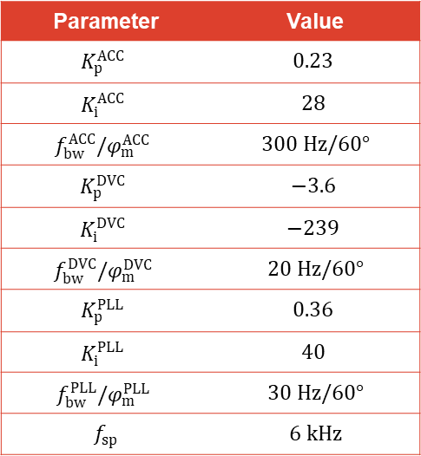
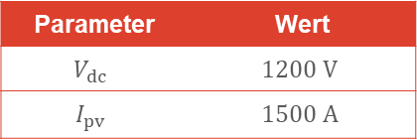

Inverter 2 : $3 kHz$, $2 MW$
Inverter and grid parameters
Opearation point
Controller requirements
use controller design code
Select with delay
Set delay as ${2−sT_{d}}/{2+sT_{d}}$
Parameter | Wert
$P_{max}$ | $$2 MW$$
$$f_{sw}$$ | $$3 kHz$$
$$v_{dc,max}$$ | $$1500 V$$
$$C_{dc}$$ | $$15 mF$$
$$L_{1}/R_{1}$$ | $120 μH /$ $1 mΩ$
$$C_{ }$$ | $$1 mF$$
$$L_{2}/R_{2}$$ | $40 μH /$ $1 mΩ$
$v_{grid,ll,rms}$ | $$550 V$$
$R_{d}/K_{AD}$ | $0.05 Ω/$ $0.05 Ω$
Parameter | Value
$$K_{p}^{ACC}$$ | $$0.23$$
$$K_{i}^{ACC}$$ | $$28$$
$$f_{bw}^{ACC}/φ_{m}^{ACC}$$ | $$300 Hz/60°$$
$$K_{p}^{DVC}$$ | $$−3.6$$
$$K_{i}^{DVC}$$ | $$−239$$
$$f_{bw}^{DVC}/φ_{m}^{DVC}$$ | $$20 Hz/60°$$
$$K_{p}^{PLL}$$ | $$0.36$$
$$K_{i}^{PLL}$$ | $$40$$
$$f_{bw}^{PLL}/φ_{m}^{PLL}$$ | $$30 Hz/60°$$
$$f_{sp}$$ | $$6 kHz$$
Parameter | Wert
$$V_{dc}$$ | $$1200 V$$
$$I_{pv}$$ | $$1500 A$$

Slide 3
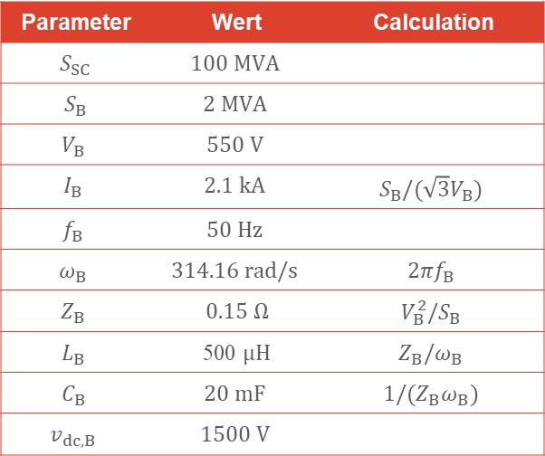
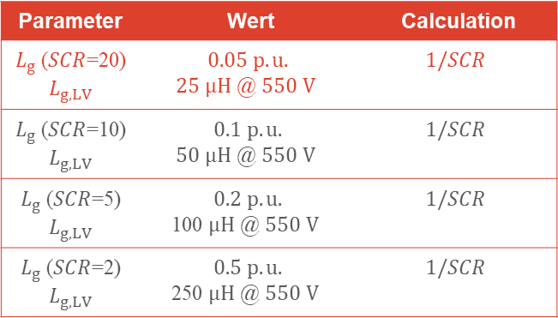
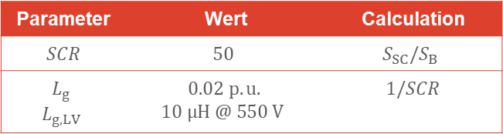
Base Value Calculation 2: Inverter Based ($2 MW$)
Base value based on inverter
Calculate base value directly on LV side
Grid impedance calculation
Parameter | Wert | Calculation
$SCR$ | $$50$$ | $$S_{SC}/S_{B}$$
$$L_{g}$$ $$L_{g,LV}$$ | $$0.02 p.u.$$ $$\text{10} μH\text{ @ }550 V$$ | $$1/SCR$$
Parameter | Wert | Calculation
$S_{SC}$ | $$100 MVA$$
$S_{B}$ | $$2 MVA$$
$$V_{B}$$ | $$550 V$$
$$I_{B}$$ | $$2.1 kA$$ | $$S_{B}/(\sqrt{3}V_{B})$$
$$f_{B}$$ | $$50 Hz$$
$$ω_{B}$$ | $$314.16 rad/s$$ | $$2πf_{B}$$
$$Z_{B}$$ | $0.15$ $Ω$ | $$V_{B}^{2}/S_{B}$$
$$L_{B}$$ | 500 $μH$ | $$Z_{B}/ω_{B}$$
$$C_{B}$$ | $$20 mF$$ | $$1/{(Z_{B}ω}_{B})$$
$$v_{dc, B}$$ | $$1500 V$$
Parameter | Wert | Calculation
$L_{g}$ ($SCR$=20) $$L_{g,LV}$$ | $$0.05 p.u.$$ $$\text{25} μH\text{ @ }550 V$$ | $$1/SCR$$
$L_{g}$ ($SCR$=10) $$L_{g,LV}$$ | $$0.1 p.u.$$ $$\text{50} μH\text{ @ }550 V$$ | $$1/SCR$$
$L_{g}$ ($SCR$=5) $$L_{g,LV}$$ | $$0.2 p.u.$$ $$\text{100} μH\text{ @ }550 V$$ | $$1/SCR$$
$L_{g}$ ($SCR$=2) $$L_{g,LV}$$ | $$0.5 p.u.$$ $$\text{250} μH\text{ @ }550 V$$ | $$1/SCR$$

